Slide 1
Python Language Essentials
Notes:
This chapter takes a look at fundamental language issues in Python. We'll talk about how Python code is organized into modules and packages, and also discuss some of the simple built-in types and operators.

Slide 2
Contents
Defining and using modules
Defining and using packages
Basic data types
Demo folder: 03-PythonEssentials
Notes:
Section 1 describes what a module is in Python, and describes how to import existing modules into your code. We also explain how to create new modules of your own.
Section 2 discusses packages. A package is a collection of related modules. We'll describe how this mechanism works, and see how it helps you to structure large libraries.
Section 3 describes some of the common built-in types, such as numbers, boolean values, and strings. We'll also see how to manipulate these simple types.
The demos for chapter are located in the following folder:
C:\PythonDev\Demos\03-PythonEssentials

Slide 3
1. Defining and Using Modules
The Python standard library
Understanding modules
More about modules
Listing the names in a module
Notes:
Python organizes code into modules and packages. We'll discuss modules in this section, and we'll discuss packages in the next section.

Slide 4
The Python Standard Library
Python defines an extensive and powerful standard library
Comprises a large number of modules
Built-in modules are implemented in C
Provide access to low-level system functionality
E.g. file I/O
Other modules are implemented in Python
See the Lib folder in the Python installation folder
For full info, see:
https://docs.python.org/3.7/library/
Notes:
Python has an extensive library of standard modules, which allow you to perform a wide range of common tasks. Here are some of the features implemented in the standard library:
Maths
File I/O
Object persistence
Concurrent execution
Inter-process communication and networking
Compression
HTML and XML processing
Etc.

Slide 5
Understanding Modules
You can create your own Python modules
Here's a simple module, which just defines some variables
To use a module elsewhere, use the import keyword
Several ways to do this:
morning = "Good morning"
afternoon = "Good afternoon"
evening = "Good evening"
greetings.py
import greetings
print(greetings.morning)
from greetings import morning, afternoon
print(morning + " " + afternoon)
from greetings import *
print(morning + " " + afternoon + " " + evening)
Notes:
It's easy to create new modules. Simply create a new Python script file, typically with a lowercase file name and the .py file extension.
The example in the slide shows a very simple module named greetings.py, which just defines three variables. In reality, modules can define variables, functions, and classes.
To use a module in Python script, use the import keyword. There are several ways to do this, as illustrated in the slide:
import modulename Imports the specified module. To use items from the module, you must use the module name as a qualifier. For example, if you import the greetings module, you can access items using syntax such as greetings.morning.
from modulename import name1, name2, etc … Imports the specified names from the specified module. This causes the named items to be added into the global symbol table of the importing module, so these names can now be used unqualified. For example, if you import the morning and afternoon items from the greetings module, you can access these items directly via the names morning and afternoon.
from modulename import * Imports all names from the specified module into the global symbol table of the importing module, so all these names can now be used unqualified. You should be careful using this, as it can easily cause name clashes when you import multiple modules.

Slide 6
More About Modules
You can access the name of a module
Use the __name__ property
Python only imports a given module once
Regardless of how many times you try to import it
Python searches the following locations for a module
The directory containing the input script (or the current directory)
The directory specified by PYTHONPATH
The installation-dependent default
import greetings
print("Name of current module is %s" % __name__)
print("Name of greetings module is %s" % greetings.__name__)
usegreetings.py
Notes:
You can use the __name__ property to get the name of the current module, or the name of a module you've imported. For example, when we run usegreetings.py in the slide, it outputs the following:
Name of current module is __main__
Name of greetings module is greetings
If you try to import the same module several times in your code, Python will only actually import it once. This is because the module might contain raw code that is performed immediately the module is loaded (the greetings.py module does this). Python ensures this code will only be executed once, the first time you import the module.
For more information about the import system in Python, see http://python.readthedocs.io/en/latest/reference/import.html.

Slide 7
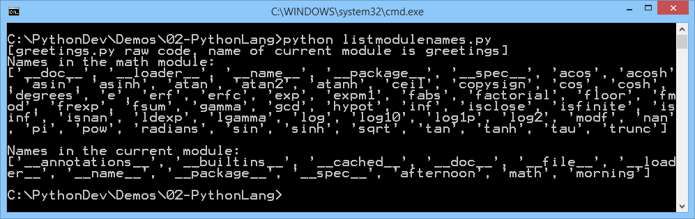
Listing the Names in a Module
You can list all the names defined in a module
Use the dir() built-in function
import math
from greetings import morning, afternoon
print("Names in the math module:")
print(dir(math))
print("\nNames in the current module:")
print(dir())
listmodulenames.py
Notes:
You can use the dir() built-in function to list all the names in a specified module. If you don't supply a parameter, it returns all the names defined in the current module.
The example in the slide shows the names in the math module, plus all the names in the current module. In this example, note that the current module includes the names morning and afternoon, which we imported from the greetings module for illustration purposes.
Note that dir() doesn't list the names of built-in functions and variables. If you want a list of those, they are defined in the standard module __builtins__. You can list them as follows:
import builtins
dir(builtins)
Note: In Python 2.x, the builtins module was named __builtin__ instead.

Slide 8
2. Defining and Using Packages
Overview of packages
Example modules
Importing specific modules
Aliasing imported modules
Importing all modules
Notes:
As we observed in the previous section of this chapter, Python organizes code into modules and packages. We discussed modules in the previous section, and we're now going to discuss packages in this section.

Slide 9
Overview of Packages
Python allows you to organise related modules into packages and sub-packages
A package is a folder that contains a file named __init__.py
Example
utils/ Top-level package, named utils.
__init__.py Initialize the utils package.
constants/ Sub-package for constants.
__init__.py Initialize the constants package.
metric.py
physics.py
...
messages/ Sub-package for messages.
__init__.py Initialize the messages package.
french.py
norwegian.py
...
Notes:
Packages are a way of structuring multiple related modules into a hierarchical folder structure. Client code can then use "dotted module named" to access modules from a package.
In technical terms, a Python package is a folder that contains a special file named __init__.py. Note that this file can be empty; the mere existence of this file is enough to tell Python to treat the folder as a package. You can also put initialization code in __init__.py, and we'll show why this is useful shortly.
Consider the example in the slide, and note the following points:
The utils folder has a file named __init__.py, so Python will treat utils as a package rather than as a regular folder.
The utils folder has a sub-folder named constants. This folder has an __init__.py file, so it's a package too (we say that constants is a sub-package of utils). The constants package contains several module files, which the client code will be able to import as utils.constants.metric and utils.constants.physics.
The utils folder has another sub-folder named messages. This folder has an __init__.py file too, so it's a package as well. The package contains several module files, which the client code can import as utils.messages.french and utils.messages.norwegian.

Slide 10
Example Modules
Here are the modules we've defined in the utils package
Modules in the utils.constants sub-package:
Modules in the utils.messages sub-package:
INCH_TO_CM = 2.54
MILE_TO_KM = 1.61
metric.py
ELECTRONIC_CHARGE = 1.602e−19
PLANCKS_CONSTANT = 6.626e−34
physics.py
HELLO = "Bonjour"
GOODBYE = "Au revoir"
french.py
HELLO = "Hei"
GOODBYE = "Ha det bra"
norwegian.py
Notes:
This slide shows the simple modules we've defined in the utils package, for the sake of our example. Our modules just define some variables; in reality, modules typically define classes, functions, and variables.
Here are the file names and folder locations for the modules shown in the slide:
utils/constants/metric.py
utils/constants/physics.py
utils/messages/french.py
utils/messages/norwegian.py

Slide 11
Importing Specific Modules
To import specific module(s) from a package:
To import specific module(s) from a package, into the current symbol namespace:
To import specific name(s) from a module from a package, into the current symbol namespace:
import utils.constants.metric
print("Inch to centimetre: %.4f" % utils.constants.metric.INCH_TO_CM)
print("Mile to kilometre: %.4f" % utils.constants.metric.MILE_TO_KM)
useutils.py
from utils.constants import metric
print("Inch to centimetre: %.4f" % metric.INCH_TO_CM)
print("Mile to kilometre: %.4f" % metric.MILE_TO_KM)
useutils.py
from utils.constants.metric import INCH_TO_CM, MILE_TO_KM
print("Inch to centimetre: %.4f" % INCH_TO_CM)
print("Mile to kilometre: %.4f" % MILE_TO_KM)
useutils.py
Notes:
Client code can use dotted module name syntax to import modules from a package. You specify the name of the package, followed by a dot, followed by the name of the module you want to import. If you have lots of nested packages, just step down the hierarchy using dots and sub-package names. Note that you can only apply a dot to a package name (i.e. a folder that has an __init__.py file in it).
Consider the examples in the slide:
In the first example, the import statement specifies the utils package, followed by the constants sub-package, followed by the metric module. You can then access names in that module by using fully qualified names, e.g. utils.constants.metric.INCH_TO_CM.
The second example is similar, but it adds the metric module to the current symbol table. You can therefore use the metric module name directly, e.g. metric.INCH_TO_CM rather than having to qualify it with the package name, e.g. utils.constants.metric.INCH_TO_CM.
The third example takes this a step further and actually imports specific names from the metric module into the current symbol table. You can therefore use names such as INCH_TO_CM directly, rather than having to qualify them e.g. utils.constants.metric.INCH_TO_CM.
Note: When you import a module from a package for the first time, Python will execute the code in the package's __init__.py file. If you import a module from a sub-package, Python executes __init__.py for both the package and the sub-package (but remember, a given __init__.py file will only be executed once).

Slide 12
Aliasing Imported Modules
You can specify a local alias for a module
Use import … as
# import a module and give it an alias.
import utils.constants.metric as metric
print("Alias example")
print("Inch to centimetre: %.4f" % metric.INCH_TO_CM)
print("Mile to kilometre: %.4f" % metric.MILE_TO_KM)
useutilsAliased.py
Notes:
The import…as construct allows you to specify a local alias for a module, as shown in the example in the slide. This can help you make your code easier to read.

Slide 13
Importing All Modules
You can use * to indicate you want to import all modules from a package
You must tell Python which modules to actually import from that package
In the package's __init__.py file …
Define a global variable named __all__ and set it to a list of all the modules to be imported
from utils.messages import *
print("Hello in French: %s" % utils.messages.french.HELLO)
print("Goodbye in French: %s" % utils.messages.french.GOODBYE)
print("Hello in Norwegian: %s" % utils.messages.norwegian.HELLO)
print("Goodbye in Norwegian: %s" % utils.messages.norwegian.GOODBYE)
useutils.py
__all__ = ["french", "norwegian"]
utils/messages/__init__.py
Notes:
The * wildcard character indicates you want to import all the modules from a package. However, Python won't automatically import everything from the package, because this could potentially drag in a very large number of modules and cause general chaos in your code.
In order to tell Python which modules to import from a package, the package's __init__.py file must define a global variable named __all__. This variable must specify a list of all the module names to be imported.
Consider the example in the slide:
The client code in useutils.py attempts to import everything from the utils.messages package.
The utils.messages package has an __init__.py file, which defines a global variable named __all__. This variable indicates that "all modules" for this package means "import the french and norwegian modules".
The client code can use names from the utils.messages.french and utils.messages.norwegian modules.
Note: There are some differences between Python 2.* and Python 3.* regarding the location of modules. There is a distinction between relative imports and absolute imports. For more information about this, see https://docs.python.org/2/whatsnew/2.5.html#pep-328-absolute-and-relative-imports.

Slide 14
3. Built-in Types
Numbers
Numeric operators
Bitwise operators
Using the math module
Booleans
Relational operators
Boolean logic operators
Operator precedence
Strings
Other built-in types
Notes:
This section describes the built-in types in Python, and also introduces some of the operators and functions you can use with these types.
We're going to focus on numbers, boolean values, and strings. We'll also summarize some of the more complex built-in types such as lists, ranges, tuples and sets, and come back to discuss them in more detail later in the course.

Slide 15
Numbers
Python has three numeric types
Integers
Floating point numbers
Complex numbers
i1 = 12345
i2 = 1234567890123456789
i3 = int("123", 8)
print("%d %d %d" % (i1, i2, i3))
f1 = 1.23
f2 = 4.56e-34
f3 = 7.89e+34
f4 = float("123.45")
print("%g %g %g %g" % (f1, f2, f3, f4))
c1 = 1 + 2j
c2 = 3 - 4j
c3 = 5j
c4 = complex("6+7j")
print("%g + %gi" % (c1.real, c1.imag))
print("%g + %gi" % (c2.real, c2.imag))
print("%g + %gi" % (c3.real, c3.imag))
print("%g + %gi" % (c4.real, c4.imag))
numbers.py
Notes:
Python has just three numeric types:
Integers - these are whole numbers, with unlimited precision.
Floats - these are 32-bit floats, similar to the double data type in C.
Complex numbers - these contain a real and imaginary part. The imaginary part is denoted by a letter j after a number. The real and imaginary parts are both float types.
Note that booleans are a subset of integers in Python. We'll discuss booleans shortly.
The example in the slide shows various examples of how to create numeric values. Note the following points in particular:
The int(), float(), and complex() functions are constructors. They create a number of the appropriate type from a string. The int() function can take an optional base as a second parameter, e.g. 16 means hexadecimal.
When we print out numbers, %g means "general". It allows Python to choose the best way to output the number (e.g. as a whole number, or as a fraction using E notation).
When we print out the complex numbers, note that complex numbers have real and imag properties to get/set the real and imaginary parts of the number.

Slide 16
Numeric Operators
Python supports the following operators on numbers
x ** y
pow(x, y)
divmod(x, y)
c.conjugate()
complex(re, im)
float(x)
int(x)
abs(x)
+x
-x
x % y
x // y
x / y
x * y
x - y
x + y
Notes:
You can use these operators for all types of numbers, except complex numbers. Note the following general points:
** is the power operator, i.e. it's equivalent to calling the pow() function.
divmod() returns the pair of values (x // y, x % y).
conjugate() conjugates the complex number (i.e. negated imaginary part).
% returns the remainder of x / y.
// returns the floored quotient of x and y, i.e. it performs integer division.
/ returns the quotient of x and y.
Note that Python supports mixed arithmetic. If you use a binary operator with different types of operands, Python will widen the narrower type to the wider type (i.e. from integer, to float, to complex).
Also note that Python 2 integer division yields an integer result. For example, in Python 2, 7/2 gives 3 (not 3.5). For more information about this, see https://www.python.org/dev/peps/pep-0238.

Slide 17
Bitwise Operators
Python supports the following bitwise operators on integers
~x
x >> n
x << n
x & y
x ^ y
x | y
Notes:
You can use these bitwise operators on integer values. Note the following points:
~ returns the bit-wise negation, i.e. all the bits are inverted.
>> shifts the bits right by the specified number of bits.
<< shifts the bits left by the specified number of bits.
& performs a bit-wise "and" of the two operands.
^ performs a bit-wise "exclusive or" of the two operands.
| performs a bit-wise "inclusive or" of the two operands.

Slide 18
Using the math Module
The math module defines several useful mathematical constants and functions
For details, see https://docs.python.org/3.7/library/math.html
Example
import math
print(dir(math))
print("pi is %f" % math.pi)
print("360 degrees in radians is %g" % math.radians(360))
print("2 * pi radians in degrees is %g" % math.degrees(2 * math.pi))
print("sin(90 degrees) is %.4f" % math.sin(math.pi / 2))
print("cos(90 degrees) is %.4f" % math.cos(math.pi / 2))
print("acos(0) is %g degrees" % math.degrees(math.acos(0)))
print("hypoteneuse of right-angled triangle (sides 3, 4) is %g" % math.hypot(3, 4))
print("5 factorial is %g" % math.factorial(5))
usemath.py
Notes:
The math module includes several useful constants and functions. The example in the slide shows several examples, and also lists all the available names in the module. This is the output of the program:

Slide 19
Booleans
Boolean is a built-in type
Represents truth or falsehood
The following values are considered false:
None
False
Zero of any numeric type, e.g. 0, 0.0, 0j
Any empty sequence, e.g. '', (), []
Any empty mapping, e.g. {}
All other values are considered true
Including the True keyword ☺
Notes:
Python has a relaxed view on boolean truth and falsehood, as described on the slide.

Slide 20
Relational Operators
Python supports the following relational operators
<
<=
>
>=
==
!=
is
is not
Notes:
No great surprises here, but a few observations:
The is operator tests for object identity, i.e. do two variables point to the same object. We'll come back to this point later in the course, when we cover objects and classes.
The is not operator tests for negated object identity, i.e. do two variables point to different objects.
The <, <=, > and >= operators raise a TypeError exception if you compare a complex number with another built-in numeric type; or if you compare objects of different types that can't be compared; or if you compare objects where there is no defined ordering.
Non-identical instances of a class normally compare as non-equal unless the class defines the __eq__() method.
Objects of different types never compare equal.

Slide 21
Boolean Logic Operators
Python has thee boolean logic operators:
not
and
or
Example
month = int(input("Enter a month number [1-12]: "))
is_summer = month >=6 and month <= 8
is_winter = month == 12 or month == 1 or month == 2
is_transition_season = not(is_winter or is_summer)
print("%s %s %s" % (is_summer, is_winter, is_transition_season))
booleans.py
Notes:
Python uses the keywords not, and, or for boolean logic. These operators have the precedence shown in the slide (from high priority to low priority), in case you want to string them together into complex logic statements.
Note that and and or are short-circuit operators, so they only evaluate the second operand if necessary to determine the overall result:
and will only evaluate the second operand if the first operand is true.
or will only evaluate the second operand if the first operand is false.

Slide 22
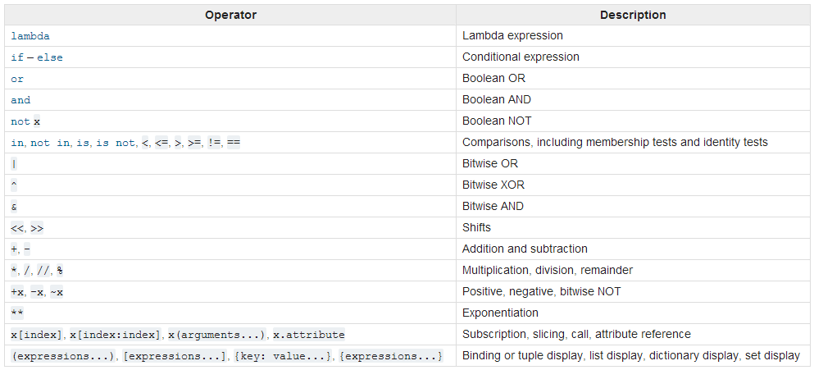
Operator Precedence
This table shows the precedence of all the operators in Python, from low precedence to high precedence
Notes:
This table shows the precedence of all the operators in Python, listed from lowest precedence to highest precedence. Operators in the same box have the same precedence.
We've covered most of these operators in this chapter. We'll cover the other operators later in the course.

Slide 23
Strings
A string is an immutable sequence of Unicode characters
Can enclose in single quotes, double quotes, or triple quotes
The String class defines many methods
For details, see https://docs.python.org/3.7/library/string.html
There's also excellent support for regular expressions
For details, see https://docs.python.org/3.7/library/re.html
str1 = "The computer says 'No' I'm afraid."
str2 = '<a href="www.bbc.co.uk">Click here for the BBC</a>'
str3 = """Birthday present ideas:
- Bugatti Chiron
- 4xHD OLED 64-inch TV
- Socks"""
print("%s\n%s\n%s" % (str1, str2, str3))
strings.py
Notes:
The String class is widely used in Python programs, as you can imagine. The important point to note is that strings are immutable in Python; all the methods that seem to modify strings actually return a mutated copy, and leave the original string in-tact.
For full information about the String class, see the Python 3.7 online documentation at the following URL:
https://docs.python.org/3.7/library/string.html
Regular expressions are also very popular in many Python applications. For more details, see:
https://docs.python.org/3.7/library/re.html

Slide 24
Other Built-In Types
Text sequence types
String - see previous slide
Basic sequence types
List, tuple, and range
Binary sequence types
bytes, bytesarray, and memoryview
Set types
set, frozenset
Mapping type
dict
Notes:
Basic sequence types:
List - a mutable sequence.
Tuple - an immutable sequence.
Range - an immutable sequence of numbers, typically used in for loops.
Binary sequence types:
bytes - an immutable sequence of single bytes, typically used for passing ASCII characters over networks.
bytesarray - a mutable counterpart to bytes.
memoryview - an object that allows Python code to access the internal data of an object that supports the buffer protocol (e.g. a bytes or bytesarray object) without copying.
Set types:
set - an unordered mutable collection of distinct objects.
frozenset - an unordered immutable counterpart to set.
Mapping type:
dict - a mutable collection of key-value pairs.
We'll discuss all these types later in the course.

Slide 25
Any Questions?

